Slide 1
Eight Principles Identify Morally Responsible Relationships
Public
Client and employer
Product
Judgment
Management
Profession
Colleagues
Self
1-<number>

Slide 2
Act Consistently with Public Interest
1.01 “Accept full responsibility for own work”
1.02 Balance competing interests
1.03 Approve software only if it is safe
1.04 Disclose actual/potential dangers
1.05 “Cooperate in efforts to address” public concerns
1.06 “Be fair and avoid deception in all statements”
1.07 Consider factors that diminish access to software
1.08 “Volunteer professional skills to good causes”
1-<number>

Slide 3
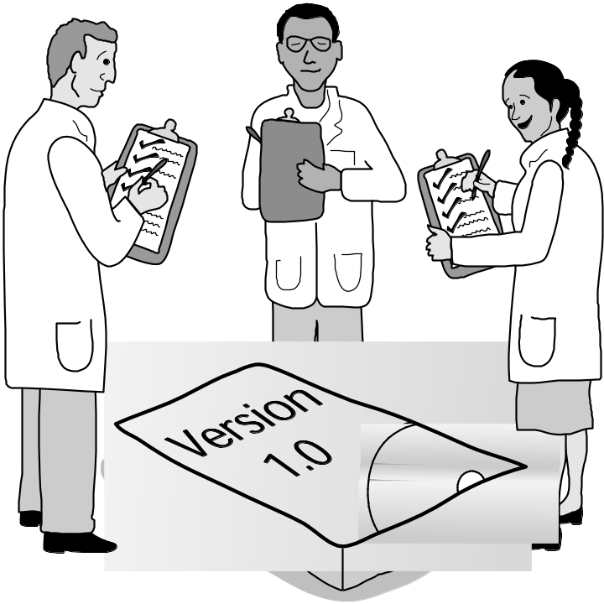
Clause 1.03
Approve Software Only If It Is Safe
1-<number>

Slide 4
Act in Best Interest of Client, Employer
2.01 Act within areas of competence
2.02 Don’t use software obtained illegally
2.03 Only use property in authorized ways
2.04 Ensure documents are approved
2.05 Respect confidentiality
2.06 Promptly report problems with project
2.07 Report issues of social concern
2.08 Refuse outside work detrimental to job
2.09 Put employer’s/client’s interests first, unless overriding moral concern
1-<number>

Slide 5
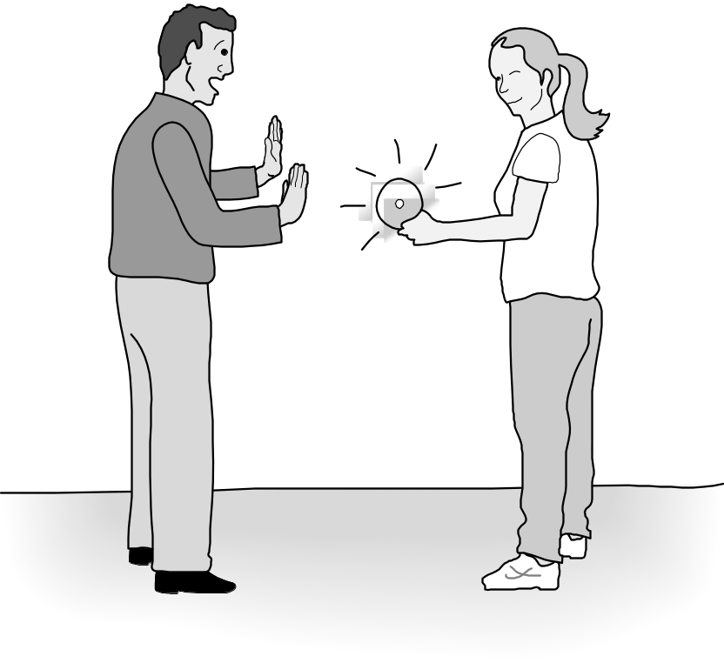
Clause 2.02
Don’t Use Software Obtained Illegally
1-<number>

Slide 6
Ensure Products Meet Highest Standards
3.01 Aim for “high quality, acceptable cost and a reasonable schedule,” making trade-offs clear
3.02 “Ensure proper and achievable goals”
3.03 Face up to “ethical, economic, cultural, legal and environmental” issues
3.04 Ensure you are qualified for proposed work
3.05 Use appropriate project methodologies
3.06 Follow the most appropriate professional standards
3.07 “Strive to fully understand the specifications”
3.08 Ensure the specifications are correct and approved
1-<number>

Slide 7
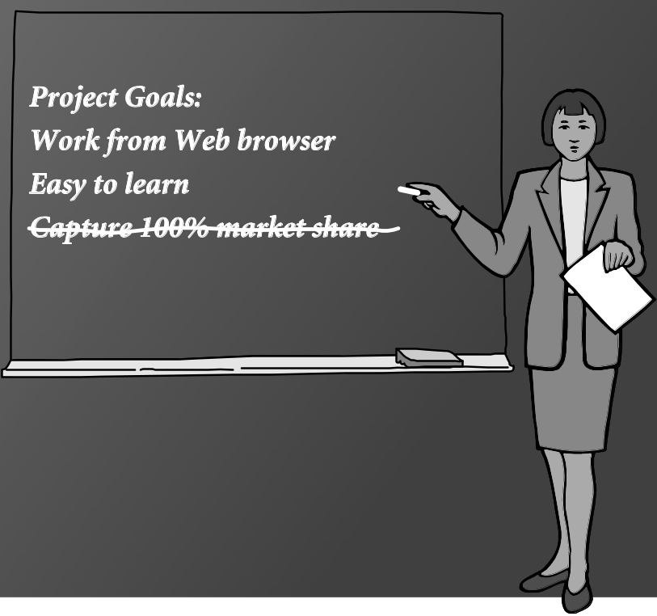
Clause 3.02
“Ensure Proper and Achievable Goals”
1-<number>

Slide 8
Ensure Products Meet Highest Standards
3.09 “Ensure realistic quantitative estimates of cost, scheduling, personnel, quality and outcomes”
3.10 “Ensure adequate testing, debugging, and review of software and related documents”
3.11 “Ensure adequate documentation”
3.12 Develop software and documents that respect privacy of those affected by software
3.13 Use only accurate data appropriately acquired
3.14 Maintain data integrity
3.15 Use same standards for software maintenance as software development
1-<number>

Slide 9
Maintain Integrity in Professional Judgment
4.01 “Temper all technical judgments by the need to support and maintain human values”
4.02 Understand and agree with documents before endorsing them
4.03 Remain objective when evaluating software or related documents
4.04 Do not engage in deceptive financial practices
4.05 Disclose conflicts of interest
4.06 Do not participate in decisions in which you, your employer, or your client has a potential conflict of interest
1-<number>

Slide 10
Promote Effective Project Management
5.01 Ensure good project management procedures
5.02 Ensure software engineers know standards
5.03 Ensure software engineers know policies and procedures for protecting confidential information
5.04 Take employees’ abilities into account before assigning work
5.05 Ensure reasonable estimates are made
5.06 Give full and accurate information to potential employees
1-<number>

Slide 11
Promote Effective Project Management
5.07 Pay employees fairly
5.08 Do not unjustly prevent a qualified person from taking a job
5.09 Work out fair intellectual property agreements
5.10 Provide employees charged with misconduct due process
5.11 Do not ask someone to do anything violating the Code
5.12 “Do not punish anyone for expressing ethical concerns about a project”
1-<number>

Slide 12
Advance the Profession
6.01 Help create an environment supporting ethical conduct
6.02 “Promote public knowledge of software engineering”
6.03 Participate in professional activities
6.04 Support others who are trying to follow this Code
6.05 Do not promote self-interest at expense of profession, client, or employer
6.06 Obey all laws unless there is an overriding public interest
6.07 Do not deceive others regarding the characteristics of software
1-<number>

